Slide 1
Family Systems Theory
Ch. 5

Slide 2
Basic Assumptions
The _____ is greater than the sum of the parts.
Rob Thomas solo career vs. Matchbox 20

Slide 3
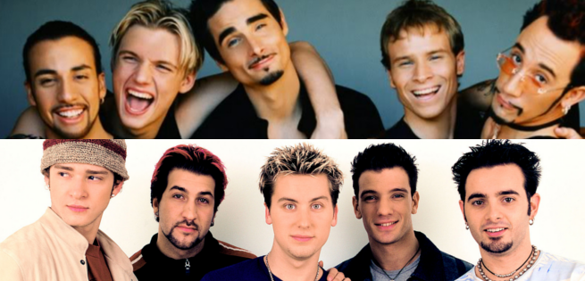
Basic Assumptions

Slide 4
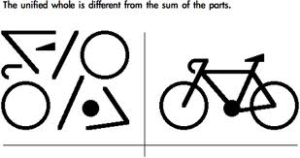

Slide 5
Basic Assumptions
  The _______ (entity) has its own characteristics, rules, roles, communication patterns and power structure.

Slide 6
Basic Assumptions
  Individual members can only be understood within the context of the _____.

Slide 7
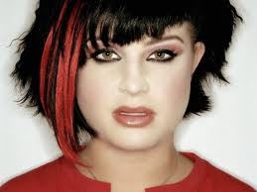
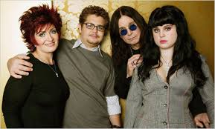

Slide 8
Basic Assumptions
2. The _____ of pathology is not within the person but is a system dysfunction.
Translated: problems are a symptom of a dysfunctional family system, not a ______ individual.
Examples of problems people have?
Or Identified Patient (IP)?

Slide 9

3. _______ causality guides behavior.
Not This:

Slide 10
S→R is focused on the problem.
Who started the argument that led to the fight?
Get at the root of the problem.
Circular causality represents a shift in thinking about the ______

Slide 11


Slide 12
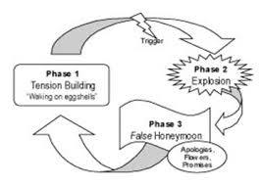
Circular Causality

Slide 13
What happens when these two get together?
____functioner
  Laid back
  Tends not to plan
  Disorganized
  Fun loving
  Spontaneous
____functioner
  High strung
  Likes to plan
  Highly organized
  More serious
  Less Spontaneous

Slide 14
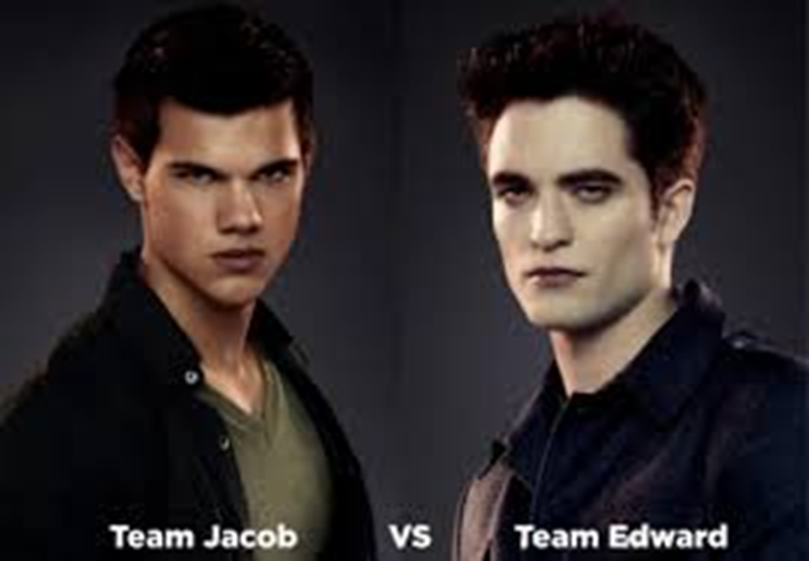
Who fits what pattern?

Slide 15
Basic Assumptions
4. _____ result from the redundancy principle and are critical in defining a family.
Families select a few responses to situations and _____ those over and over again.
What were some unspoken rules in your family?
What unspoken family rules have you discovered in relationships with others?

Slide 16
Pursuer Distancer Circular Pattern
https://www.youtube.com/watch?feature=player_embedded&v=uHRvY1QnFEg 4:51
Rules about conflict in Early Marriage.
Unhealthy relationship patterns we repeat
https://www.youtube.com/watch?v=leiKdNE9qWk 2:58

Slide 17
Basic Assumptions
Feedback loops guide behavior
______ feedback loop→when a family member behaves in a way that is unacceptable other family members move to stop that behavior.

Slide 18
______ Feedback loop→rewarding response for behaviors whether they lead to family change or family maintenance.

Slide 19
Basic Assumptions
6. Pathological communication contributes to relationship _______.
Pathological Communication→ ways of relating that are unclear, problematic and lead to relationship problems.

Slide 20
Basic Assumptions
6. Pathological communication contributes to relationship problems.
Double ____= when verbal and nonverbal messages do not match.
No good solution to the situation.

Slide 21
A Message From Disney…
What are the verbal messages in this song?
What are the non-verbal messages?
What options does the girl have?
How might she feel about each option?
https://www.youtube.com/watch?v=VTyxDZlBVoU 1:59

Slide 22
Basic Assumptions
7. All family members take on roles.
Roles are: recurring patterns of behavior developed through ________ that family members use to fulfill family functions.
What were/are some of your family roles?

Slide 23
Basic Assumptions
8. Family Types are based on the _____ of family boundaries.
_____ families→democratic, rights of members protected, interactions with outsiders permitted, loving, respectful and flexible.

Slide 24
Basic Assumptions
8. Family Types are based on the rigidity of family boundaries.
______ families→No boundaries, few rules, low investment in family entity. Children see lack of investment as lack of love.

Slide 25
______family→ family members are enmeshed or overly involved in each other’s lives. Individual identities not allowed and family is largely closed to outside world.

Slide 26
Closed family→
Ex. Enmeshment Everybody Loves Raymond
Ex. Enmeshment, closed family, negative feedback loop: Flora Jessop escapee from an FLDS Community Compound in Utah/Arizona

Slide 27
Application Activity
Apply Concepts to Everybody Loves Raymond
Episode:The Plan

